Slide 1
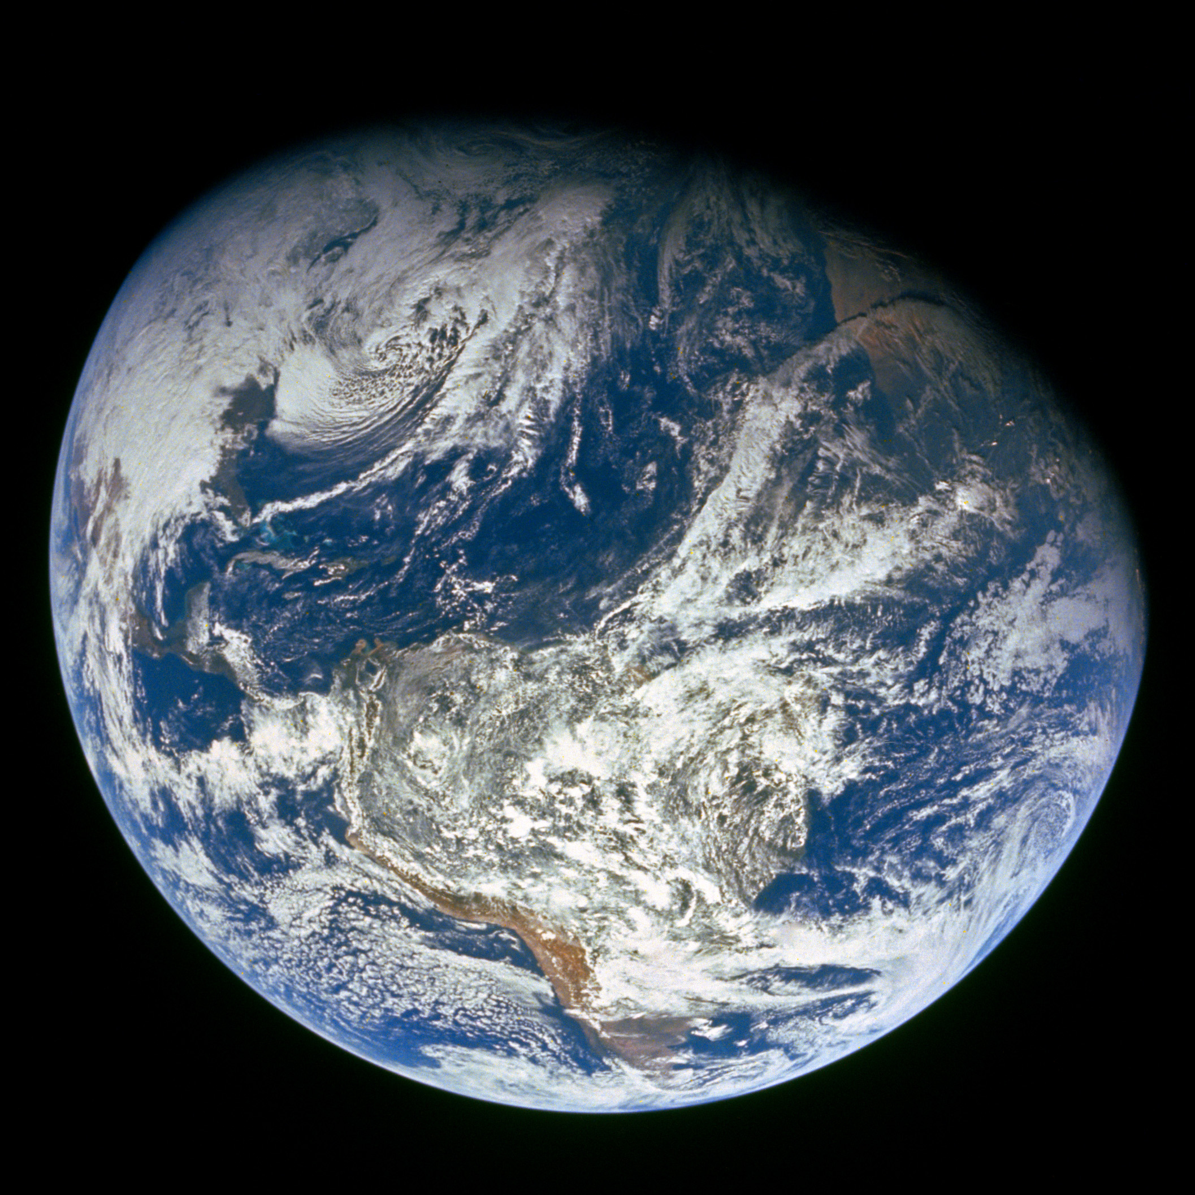
GENESIS
”In the beginning God…”

Slide 2
Review
From nothing (Hebrews 11:3) to Man was six literal days
  All of the “creating” and “making” that God did ended the seventh day Genesis 2:3
  God created ”heaven and earth” according to Genesis 1:1. And God moved Moses to write that he made “heaven and earth” and everything in it, in six days. Exodus 20:11
  Adam and Eve looked like a man and woman, not an infant (Genesis 2:21-25) though they were but one day old. The earth was divided by land and sea, teaming with life at six days and lighted by the stars made two days prior. Any “appearance of age” that man or the earth had cannot be called “deception” when God told us what he did. Genesis 1

Slide 3
Review
Jesus pointed back to Genesis - God intended for man and wife to “cleave…and...be one flesh” - not divided. Genesis 2:24; Matthew 19:4-6
  No divorce is a general rule. God provided an allowance for divorce under the OT (Deuteronomy 24:1) as well as under the NT (Mathew 19:9; 5:32)
    Under our covenant, God allows one to divorce their spouse only for the cause of literal adultery (literal adultery – Matthew 5:32 versus figurative adultery – Matthew 5:28).

Slide 4
Review
Thorns and thistles remind us of Adam’s sin. This earth is not and will never be a paradise.
  We will return to dust, and the earth will one day be dissolved 2 Peter 3:11
  We must live holy lives 2 Peter 3:11

Slide 5
Cain, Abel, and Seth Genesis 4 – 5
Cain’s sin and its consequences Genesis 4:1-15
Cain’s lineage Genesis 4:6-15
Seth’s lineage Genesis 4:25 – 5:32

Slide 6
Cain’s sin and the consequences Genesis 4:1-15
Cain and Abel’s occupation Genesis 4:1-2
Cain and Abel’s worship Genesis 4:3-5
  Abel’s offering was by faith Hebrews 11:4
  What is “faith” and how do we get it? Hebrews 11:6; Romans 10:17
  What is “righteousness” 1 John 3:7; Hebrews 11:7b
  What is “sin” 1 John 3:4
  Abel was declared righteous (Hebrews 11:4). He believed God and did what God said.
  Cain was wicked (1 John 3:12). He did not do what God said – but could have. Genesis 4:7

Slide 7
Cain’s sin and the consequences Genesis 4:1-15
Cain and Abel’s worship Genesis 4:3-5
  Free will – endure temptation and do not err James 1:12-16
  Cain’s offering illustrates that it matters how we worship
    Cain didn’t get credit for using his talents when he violated God’s instructions Genesis 4:5
    “In vain do they worship me…” Matthew 15:9
    Everything that we do must be in the name of the Lord Colossians 3:17

Slide 8
Cain’s sin and the consequences Genesis 4:1-15
Dealing with sin Genesis 4:6-15
  God did not accept Cain’s offering Genesis 4:5
  Don’t compound sin with sin Genesis 4:5,8
  Acknowledge and correct it Ezekiel 18:21
  Rule over it Genesis 4:7; James 4:7
  May have earthly consequences Genesis 4:11; Romans 1:27
  God is merciful - we may find mercy even for temporal things Genesis 4:15; Joel 2:12-14 (“who knoweth if he will return and repent, and leave a blessing…”); 2 Samuel 12:22 (“who can tell whether God will be gracious to me…”)

Slide 9
Cain’s lineage Genesis 4:16-24
  ”And Lamech took unto him two wives”
    This is prior to the law of Moses – I don’t know details.
    Under Moses covenant, God said this to David in 2 Samuel 12:8: “And I gave thee thy master’s house, and thy master’s wives into thy bosom…”
    But what matters to us (whether in Africa or Salt Lake City) is NOT what Lamech or David did, but what is written within our covenant. Polygamy is not allowed. Romans 7:2-3 “if while her husband liveth, she be married to another man…”
    As we study Genesis, remember that we are reading “what was written aforetime” (Romans 15:4), not the law of Christ (1 Corinthians 9:21). We should follow the example of Abel’s faith (Hebrews 11:4) but not his law.
    The faith and the facts of Genesis (Hebrews 11:3-4) are well applicable to us today. But their law is not.

Slide 10
Cain’s lineage Genesis 4:16-24
  ”And Lamech took unto him two wives”
    “Moral law is a reflection of God’s character and never changes?” No, law directing moral issues did change with the covenant, reference Matthew 5. Abide in the God’s word (John 8:31-32), not in clichés.
    As we read the from the Old Testament during these next two years of our 4 year study through the Bible, whether we see people involved in animal sacrifice, instrumental music, sabbath observance, polygamy, or vengeance, remember that WE are “under law to Christ” not Moses. 1 Corinthians 9:21

Slide 11
Seth’s lineage Genesis 4:25 – 5:32
  Men began to call upon the name of the Lord – the very thing God made man to do. Men began to seek the Lord in an effort to do his will. Acts 17:27; Zephaniah 3:9; Romans 10:13
  Enoch walked with God. He pleased God. Genesis 4:24; Hebrews 11:5
  Why are Abel, Enoch and Noah listed for us in Hebrews 11? As examples to follow.
  Noah was 500 and begat Shem, Ham, and Japheth

Slide 12
Summary and Application
  Sin has consequences - spiritual and maybe physical
  We must rule our spirit. Genesis 4:7; James 4:7
  God cares how men worship Him. John 4:24
  We should imitate the faith of righteous men of old, but act in faith according to the law under which we live. Hebrews 12:1-2; 1 Corinthians 9:21 If we imitate Abel’s faith and listen to God, we too will be righteous.

